Slide 1
STUDIO PRE-OPERATORIO
L’importanza di una
Endoscopia mirata
Vito Annese
Gastroenterologia IRRCS Pol. S. Donato
Universita’ Vita e Salute, S. Raffaele

Slide 2
Disclosure
I have no conflict of interest to disclose for this lecture

Slide 3
Pre-Op Endoscopy - Background
The rationale for performing an EGD before bariatric surgery is to detect and/or treat lesions that might potentially affect the type of surgery performed, cause complications in the immediate postoperative period, or result in symptoms after surgery
However, the need for EGD before bariatric surgery is controversial.

Slide 4
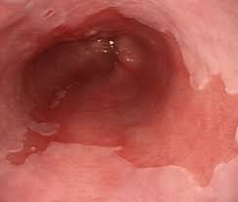
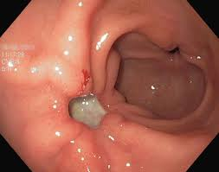
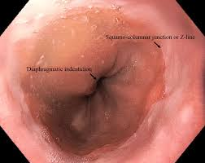
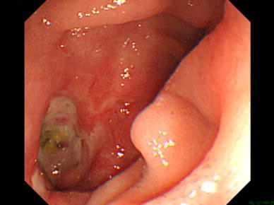
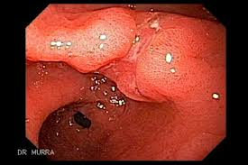
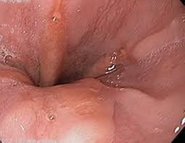
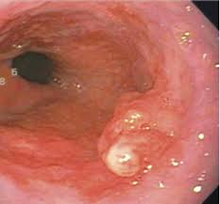
Most common pre-op endoscopy findings in obese
Bennett S et al. Surg Obes Rel Dis 2016;12:1116-1125 (48 studies, 61,421 patients)

Slide 5
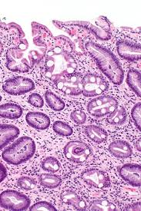
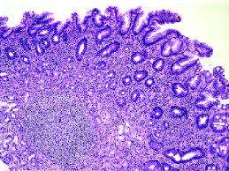
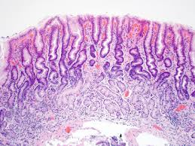
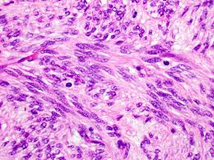
Most common pre-op pathology findings in obese
Wang S et al. Obes Surg 2021;31:337-42 (59 studies, 32,789 patients)

Slide 6
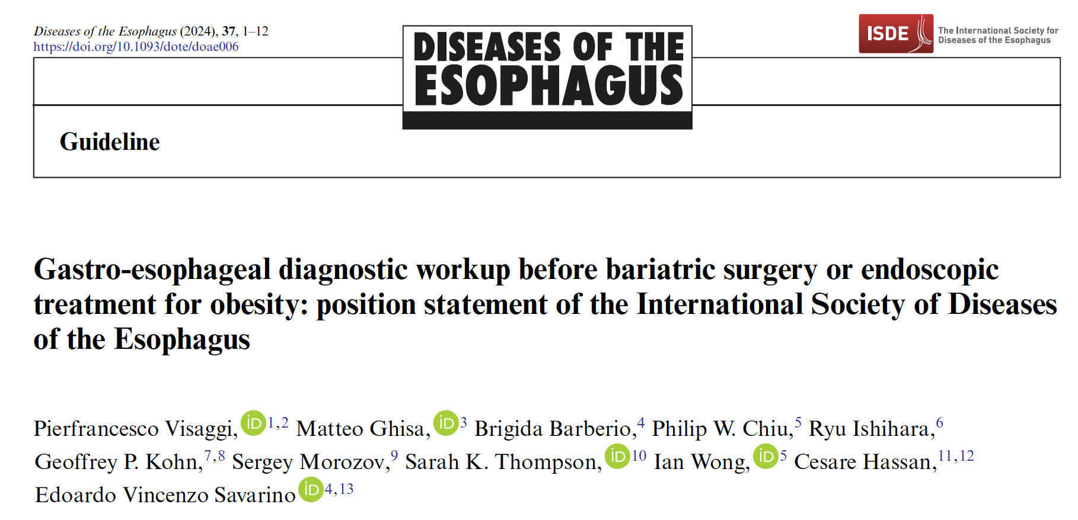

Slide 7
Statement 1
Preoperative esophagogastroduodenoscopy should be considered in all patients planning to undergo bariatric surgery.
Conditional Recommendation – Low Quality Evidence (Agree=90%)
Visaggi PF et al. Diseases of the Esophagus (2024), 37, 1–12

Slide 8
Statement 1
In a meta-analysis on 594 patients, an association has been demonstrated between obesity and reflux esophagitis (OR=2.23, 95%CI:1.6 - 3.1, P=0.000), erosive gastritis, gastric and duodenal ulcers (OR=1.40, 95% CI:1.14–1.7, P=0.001)[1]
In another meta-analysis, the pooled adjusted OR of esophageal adenocarcinoma for BMI of 25 or greater was 2.02 (95% CI:1.5–2.7; P=0.001), with a trend toward a dose–response relationship [2]
A meta-analysis on 13,434 patients undergoing endoscopy prior to bariatric surgery, found a prevalence of Barrett’s esophagus of 0.9% (95% CI:0.7%–1.3%; P<0.001)[3]
1.Kim HJ, et al J Gastroenterol Hepatol 2007;22(4):477–81.
2.Hampel H, et al. Ann Intern Med 2005;143(3):199–211.
3.Qumseya B, et al. Endoscopy 2020;52(7):537–47.

Slide 9
Statement 1
A change in surgical management of candidates for bariatric surgery following EGDS has been reported in the range of 3.9% (95% CI: 3%–4.8%) to 20.6% (95% CI: 14.5%–28.2%)
The proportion of medical management changes ranged from 0% to 70.2% in single studies and was mainly due to Helicobacter pylori (HP) eradication (76.4%) and medical therapy for gastritis or GERD (23.5%)
Bennett S, et al. Surg Obes Relat Dis2016;12(5):1116–25.

Slide 10
Statement 2
Identification and subsequent repair of HH larger than 2 cm may improve outcomes in patients undergoing bariatric procedures.
Conditional Recommendation—Low Quality Evidence.

Slide 11
Statement 2
HH may be present in nearly 40% of morbidly obese patients [1]
A recent meta-analysis investigated the effects of concomitant LSG and HHR in patients with GERD. From the pooled analysis of 18 randomized (n=1) and nonrandomized (n=17) studies including 937 patients, the authors found that concomitant LSG and HHR had a positive effect on weight loss, erosive esophagitis (OR=0.12), and improvement of GERD symptoms (OR=020). [2]
In addition, the OR for remission of GERD symptoms was significantly higher in patients undergoing LSG+HHR compared to LSG without HHR (OR=2.97; 95%CI: 1.8–4.9, P<0.0001).
1. Che F, et al. Surg Obes Relat Dis 2013;9(6):920–4.
2. Chen W, et al. Obes Surg 2021;31(9):3905–18.

Slide 12
Statement 2
In contrast, another meta-analysis on 838 patients found that although HHR significantly prolonged the procedure time of LSG, there was no differences in terms of GERD improvement in patients undergoing HHR+LSG or LSG alone.[1]
In a RCT, 100 obese patients with HH who were scheduled for bariatric surgery were randomized to LSG with crural repair or LSG alone. The authors found that LSG with or without HHR had comparable outcomes in terms of postoperative reflux symptoms.[2]
Evidence on a possible superiority of LSG+HHR compared to LSG alone is contradictory. Further randomized studies are needed to increase the quality of available evidence. However, current evidence suggests the need of identifying a HH and treating it accordingly.
1. Małczak P, et al. Pol Przegl Chir 2021;93(5):1–6.
2. Snyder B, Surg Obes Relat Dis 2016;12(9):1681–8.

Slide 13
Statement 7
No recommendation can be made on the screening for Helicobacter pylori infection in patients planning bariatric procedures based on currently available evidence.
Agree:81.8%. No recommendation

Slide 14
Statement 7
Prevalence estimates of HP infection in obese patients undergoing bariatric procedures are heterogeneous, with meta-analytic studies showing prevalence rates ranging from 0.13% to 49%. Similarly, the impact of HP infection on surgical outcomes is unclear.][1]
In a meta-analysis on 255,435 patients undergoing bariatric procedures, HP infection was associated with a 10-fold increase in marginal ulcers formation following RYGB compared to HP-negative patients. However, the rates of bleeding, leak, hospital length of stay was the same [2]
Another meta-analysis found that there was no difference in the incidence of post operative complications in HP-positive patients undergoing pre-operative HP eradication therapy compared to HP-negative patients [1]
1. Smelt HJM, et al. Surg Obes Relat Dis 2018;14(10):1645–57.
2. Mocanu V, et al.Obes Surg 2018;28(2):567–73.

Slide 15
Impact of pre-op Endoscopy
Sawathanon S et al. Surgical Endoscopy (2023) 37:2202–2208
Notes:
Group 1 had normal findings. Group 2 had abnormal findings that did not require a change in surgical management. Group
3 had abnormal findings that required a change in the surgical plan or caused a delay in surgical treatment. Group 4 had contraindications
to surgery
A total of 461 patient records (63.8% female) were reviewed. The mean age was 35.1 ± 11.2 years and the mean
BMI was 47.7 ± 8.7 kg/m2. The prevalence of endoscopic findings in Groups 1, 2, 3, and 4 were 42.5%, 35.6%, 21.9%, and
0%, respectively. The most common abnormal findings were non-erosive gastritis (31.2%) followed by Helicobacter pylori
infection (18.7%) and hiatal hernia (10.2%). Male sex and NSAID use were significantly associated with detection of lesions
in Group 3 either on univariate or multivariate analysis, while type 2 diabetes mellitus (T2DM) was a significant protective
factor on multivariate analysis. On subgroup analysis in patients ≥ 40 years old, multivariate analysis revealed age, BMI,
and NSAID use were significantly associated with the detection of lesions in Group 3, while T2DM was still a significant
protective factor.

Slide 16
A survey on pre-op Endoscopy
A retrospective chart review of 885 patients who underwent primary bariatric surgery
One or more abnormal EGD findings were observed in 83.2% of patients
More than half of our patients (54.7%) presented with history of heartburn, reflux, or GERD.
EGD findings demonstrated a hernia in 43.1% of patients [(Type I: 40.6%; Type II: 0.5%; Type III: 2.1%)].
Among patients who were biopsied, other findings included gastritis (32.4%), esophagitis (8.0%), eosinophilic esophagitis (4.7%), or duodenitis (2.7%)
Chen J et al. Surgical Endoscopy (2023) 37:3127–3135
Notes:
We performed a retrospective chart review of 885 patients who underwent primary bariatric
surgery at a university hospital-based bariatric surgery program between March 2011 and February 2022. Clinical history,
demographics, and preoperative EGD reports were reviewed for abnormal findings.
Results Of the 885 patients evaluated in this study, one or more abnormal EGD findings were observed in 83.2% of patients.
More than half of our patients (54.7%) presented with history of heartburn, reflux, or GERD. EGD findings demonstrated
a hernia in 43.1% of patients [(Type I: 40.6%; Type II: 0.5%; Type III: 2.1%)]. 68.0% of patients were biopsied. Among
patients who were biopsied, other findings included gastritis (32.4%), esophagitis (8.0%), eosinophilic esophagitis (4.7%),
or duodenitis (2.7%). We found ulcers in 6.7% of patients. Pathology was consistent with H. pylori in 9.8% of biopsies taken
and consistent with BE in 2.7%. Following routine p-EGD, 11.2% of patients were placed on PPI and 8.3% were recommended
to stop NSAIDs.

Slide 17
A survey on pre-op Endoscopy
Among patients who were biopsied, other findings included gastritis (32.4%), esophagitis (8.0%), eosinophilic esophagitis (4.7%),or duodenitis (2.7%).
We found ulcers in 6.7% of patients. Pathology was consistent with H. pylori in 9.8% of biopsies taken and consistent with BE in 2.7%.
Following routine p-EGD, 11.2% of patients were placed on PPI and 8.3% were recommended to stop NSAIDs.
Chen J et al. Surgical Endoscopy (2023) 37:3127–3135

Slide 18
Gastric sleeve & Barrett
Chandan S et al. Clin Gastro Hepatol 2024, pub ahead of print
Notes:
Nineteen studies with 2046 patients (79% females) were included with follow up ranged from 2 to 11.4 years. The pooled rate of de novo
BE post SG was 5.6% (CI 3.5-8.8). Significantly higher pooled rates of EE [Risk Ratio (RR)3.37], HH [RR 2.09], GER/GERD symptoms [RR 3.32] and PPI use [RR 3.65], were found
among patients post SG. GER/GERD symptoms post SG positively influenced the pooled BE rates, while age, sex, BMI, post SG EE and HH did not.

Slide 19
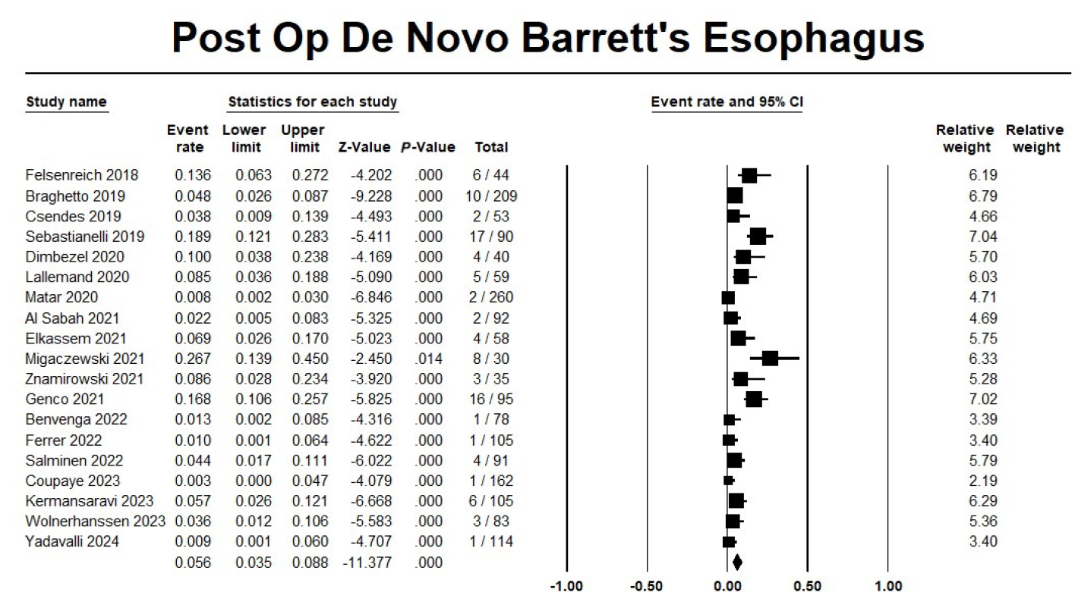
Gastric sleeve & Barrett

Slide 20
How reliable is pre-sleeve endoscopy to characterize pathological features?
Cross-sectional study examined 102 patients who underwent vertical sleeve gastrectomy from January 2023 to November 2023.
The negative predictive value of preoperative esophago-gastroduodenoscopy for detecting H. pylori infection, gastritis, metaplasia and atrophy were 95 %, 79 %, 93 %, and 98 %, respectively.
Moderate gastritis and focal metaplasia were significantly underdiagnosed preoperatively (p < 0.001).
H. pylori infection and focal metaplasia were significantly more prevalent in females after surgery (p < 0.001).
H. pylori infection and gastritis were positively correlated with increased postoperative gastroesophageal reflux disease symptoms (p < 0.001).
Heyat M et al. Ann Diagn Pathol 2024:152319
Notes:
The negative predictive value of preoperative esophagogastroduodenoscopy for detecting H. pylori infection, gastritis, metaplasia and atrophy were 95 %, 79 %, 93 %, and 98 %, respectively. In an overall view, for all pathologies, the negative predictive value was 53.4 %. Moderate gastritis and focal metaplasia were significantly underdiagnosed preoperatively (p < 0.001). H. pylori infection and focal metaplasia were significantly more prevalent in females after surgery (p < 0.001). H. pylori infection and gastritis were positively correlated with increased postoperative gastroesophageal reflux disease symptoms (p < 0.001).

Slide 21
Frequency of Clinically Significant Findings in the Surgical Pathology Specimen Following Laparoscopic Sleeve Gastrectomy and Concordance with Preoperative Endoscopy
Three hundred seventy-three patients had preoperative endoscopy and surgical pathology results available.
20/373 (5.4%) patients had potentially significant postoperative pathology, including intestinal metaplasia, autoimmune metaplastic atrophic gastritis (AMAG), gastrointestinal stromal tumors, and/or gastric cancer.
The overall incidence of AMAG in the entire cohort was 2.3%. Preoperative gastric biopsies (to include gastric body) identified AMAG in nearly 1/2 of patients.
Patients with clinically significant postoperative pathology results had a median [interquartile range] of 3 [3–5] tissue blocks examined as compared to 3 [1–3] for the remainder of the cohort (p < 0.001).
We recommend wider sampling in preoperative endoscopy (body and antrum)
Owen CK et al. Obes Surg 2024; 34:1442–1448

Slide 22
Pre-Op EGDS – High cost for low yield
31 retrospective observational studies (EGD=13,837)
Meta-analysis found 3.9% of EGDs resulted in a change in operative management
This proportion decreased to 0.3% after sensitivity analysis, as detection of hiatal hernia comprised 85.7% of findings that changed operative management.
Half of the 7.5% of cases that resulted in surgical delay involved endoscopic detection of H. pylori.
Gastric pathology was detected in a significantly greater proportion of symptomatic patients (65.0%) than in asymptomatic patients (34.1%; P<0.001).
Gretchen E et al. J Clin Gastroenterol 2020;54:398–404)

Slide 23
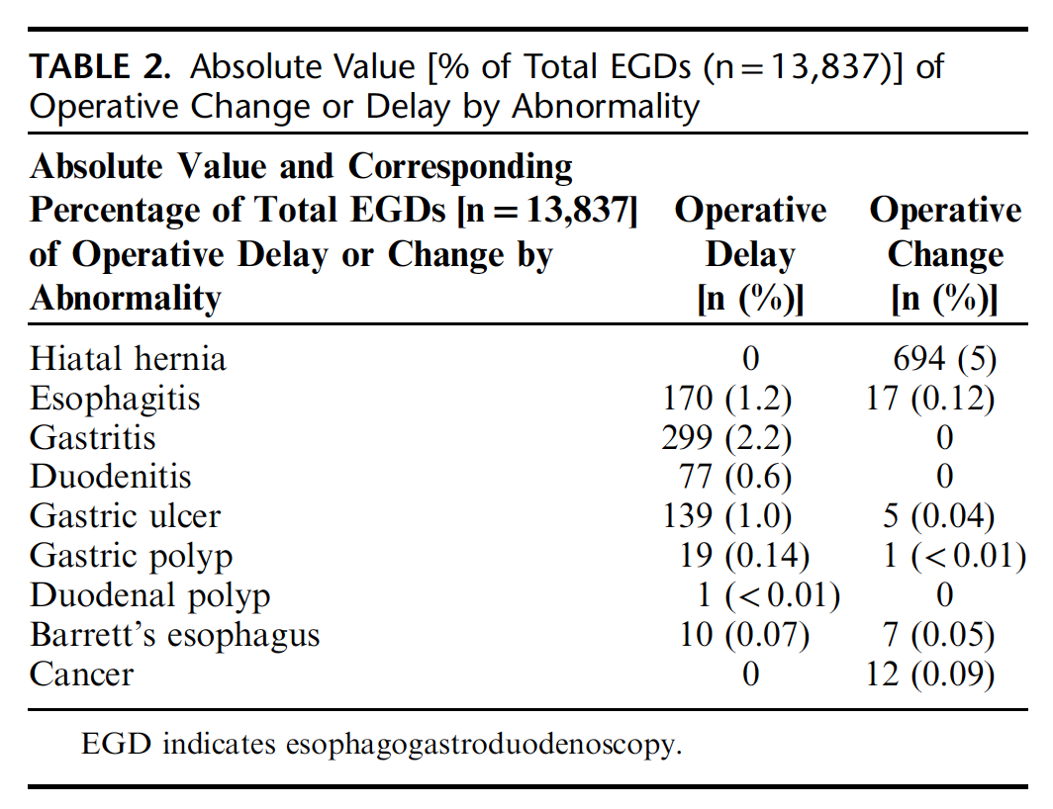
Pre-Op EGDS – High cost for low yield
Gretchen E et al. J Clin Gastroenterol 2020;54:398–404)

Slide 24
Pre-Op EGDS – High cost for low yield
The cost of routine EGD to identify any abnormality that led to a change in type of bariatric operation was $281,230 and $766,352 when controversial findings were included versus excluded, respectively.
Cost of routine EGD to identify a malignancy was $2,554,506
Estimated cost of EGD was $2215
Estimated cost including histology SSN is 140€
Cost included in bariatric package ± 230 €
Gretchen E et al. J Clin Gastroenterol 2020;54:398–404)

Slide 25
Take home messages
The performance of an upper endoscopy in a patient with reflux symptoms, dysphagia, and/or dyspepsia has been covered in multiple guidelines and is equally relevant in the preoperative patient
RYGB and DS/BPD render the distal stomach and/or duodenum inaccessible by a standard upper endoscope, the threshold for performing a preoperative endoscopic evaluation of the upper-GI tract is lower than for other surgeries
The relative low cost and possible legal implication warrant the EGD in all patients before bariatric procedures
Notes:
duodenal switch and biliopancreatic diversion (DS/BPD
Roux-en-Y gastrojejunal bypass (RYGB)

